Slide 1
Cognition Fundamentals: Perception
How do we learn from our perceptions?
Responsible Lecturer: Bram Heijligers

Slide 2
HCAI Recap
What we already learned...

Slide 3
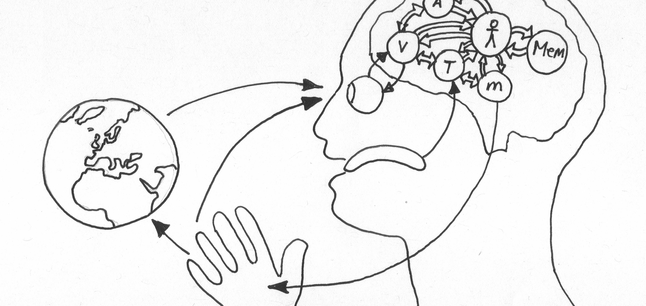
Extended Mind Theory
Objects in the external environment can be part of a cognitive process and in that way function as extensions of the mind itself.
Notes:
What does extended mind theory state? Or what is an extended mind?
[click to add definition]
Can you name some examples of mind extensions?
What is the difference between the mind and the consciousness/brain?
What is the value of Extended Mind Theory for Human Computer interaction?
What are the implications Extended Mind Theory for Human-centered Artificial Intelligence?

Slide 4
Network-Enabled Cognition Theory
The technological and informational elements of a large-scale information network can, under certain circumstances, constitute part of the material supervenience base for(/relationship between) an agent’s mental states and processes.
Notes:
What does Network-Enabled Cognition theory state?
[click to add definition]
Cognitive capacity; working memory is very limited (consicous 100 bits, unconsicious 100k bits) ; AI is only limited by the computation capacity available so it can be a great enrichment to our own intrensic cognitive capacity
Can you name some examples of network-enabled cognition?
What is the difference between the Extended Mind Theory and the network-enabled cognition?
What is the value of Network-Enabled Cognition for Human Computer interaction?
What are the implications of Network-Enabled Cognition for Human-centered Artificial Intelligence?

Slide 5

Interaction
Communication or direct involvement with someone or something: a reciprocal action or influence
Notes:
What is interaction?
[click to add definition]
Why is interaction central to the mind?
Why is interaction fundamental to data exchanges?

Slide 6
Human-Centered Artificial Intelligence
Design discipline within artificial intelligence for designing applications that are reliable, safe, and trustworthy, and effectively serve people's needs.
Notes:
Machine learning (ML) is the science of helping computers discover patterns and relationships in data instead of being manually programmed. Machine or deep learining is a powerful tool for creating personalized and dynamic experiences, and it’s already driving everything from Netflix recommendations to autonomous cars. But as more and more experiences are built with ML, it’s clear that UX designers still have a lot to learn about how to make users feel in control of the technology, and not the other way round.
What is HCAI?
[Click to add definition]
How is HCAI distinct from human-computer interaction?
Essential, products which we perceive as intelligent come with certain assumptions: specifically that the user can anticipate what the product is going to do and that the product anticipates what the user want. In other words, users expect them to respond as quasi-human.

Slide 7
Perception
What is it? How does it related to attention, memory and robotics?

Slide 8
What we learn and why
Learning Objectives
Identify appropriate perceptual features for object detection.
Identify required prior-knowledge for contextualising object detection.
Use cognitive models of pattern recognition to improve feature and/or object detection. → feeds into our object detection algorithm

Slide 9
How do we perceive?
Using our different senses: (Sherrington’s codification)
Teloreceptive (vision and hearing)
Proprioceptive (limb position)
Exteroceptive (touch)
Chemoreceptive (smell and taste)
Interoceptive (visceral, but based on later findings also includes the sense of the physiological condition of the entire body)
may reflect predictions about the expected state of the body rather than actual sensations (Barrett & Simmons, 2015)
For object detection, we’ll now focus on vision!

Slide 10

Visual Perception

Slide 11
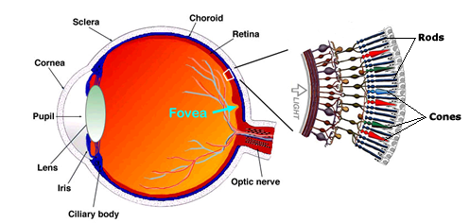
Eye movements
Saccades ~ darting movements of our eyes from one location to another; ca. 3 times/sec.
Followed by short periods of Fixations, moments during which we obtain information about the world (from the fovea)
Is our camera; Field of View moving?

Slide 12

Phenomenal stability
Visual input is disjointed and discontinuous yet we experience no sensation of movement or displacement (“shifting retinal images interleaved with smears of motion”, Higgins & Rayner, 2014)
This is called ‘saccadic suppression’ (masking)
What are the implications for our computer vision algorithm?

Slide 13
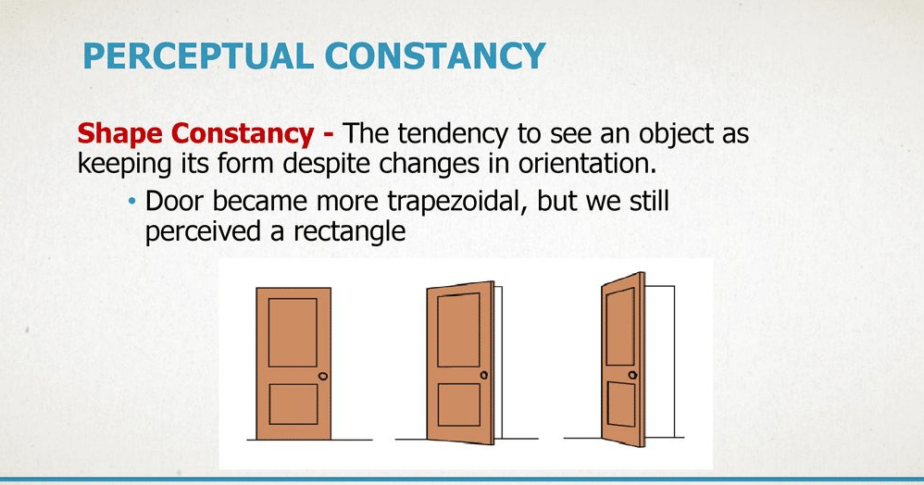
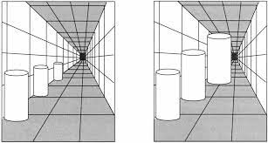
Perceptual constancy: Vision
Space Constancy: the world remains fixed even as the eyes scan across it.
Objects appear at different retinal locations after eye movements but not perceived as displaced
Size Constancy: the tendency to perceive the veridical size of a familiar object despite differences in their distance (and consequent differences in the size of the pattern projected on the retina of the eye)

Slide 14
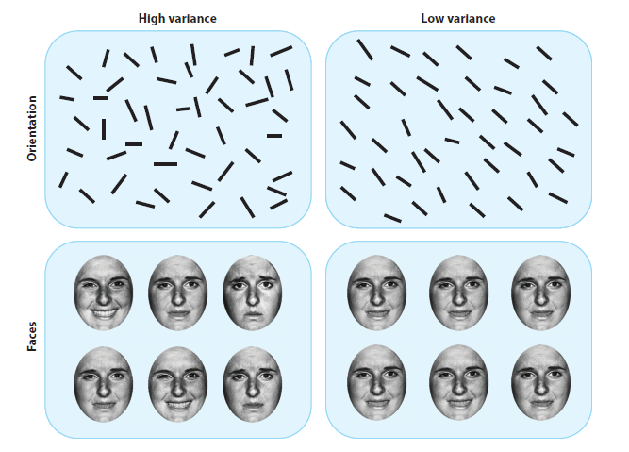
Ensemble perception (Whitney & Leib)
The visual system’s ability to detect and extract information from groups of similar objects (faces, trees, cars,…) that is statistically representative of the whole group, such as motion, orientation, brightness, hue and spatial position
Examples: average hue of tree leaves, average facial expression, average speed of moving cars on the street
Based on ‘holistic’ representations
Brief glances (100 ms or less)
View-point invariant, dynamic
Requires integration of multiple items
Likely operates in other modalities as well

Slide 15
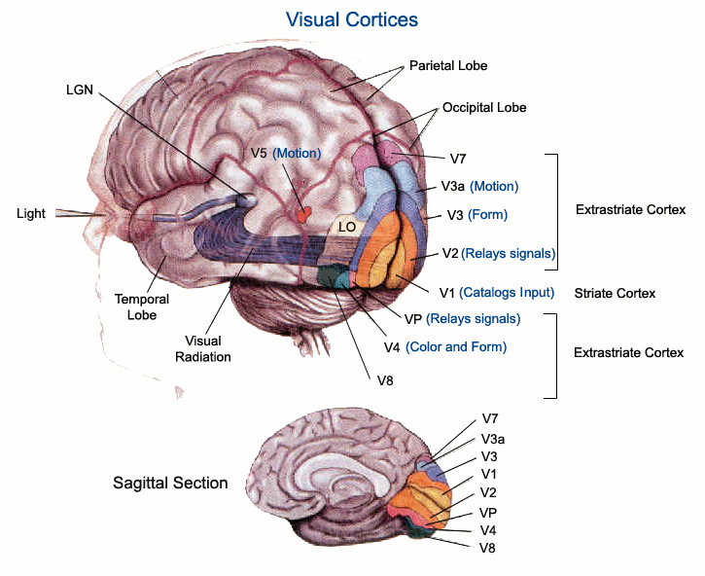
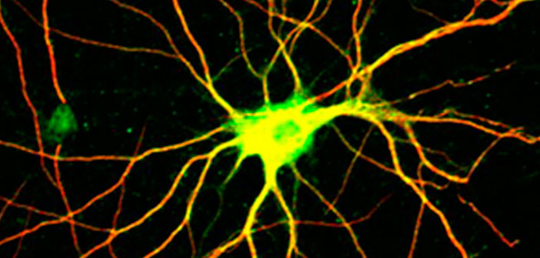
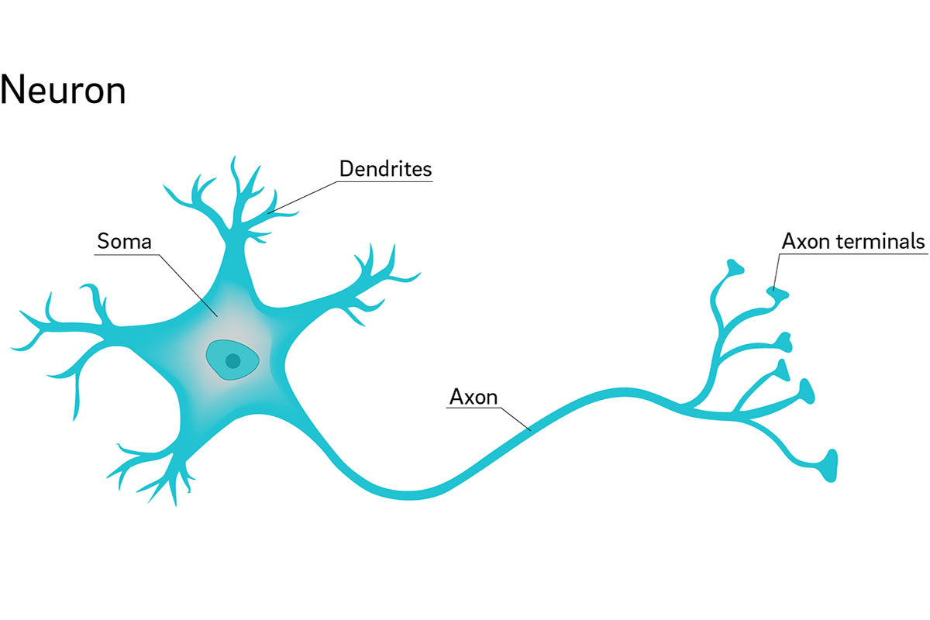
Visual Cortices
Visual perception is created by layered processing of sensory stimuli
Processing clustered in brain area using short-distance neural hubs
And communicated (relays) across the brain using long-distance single connection neurons

Slide 16
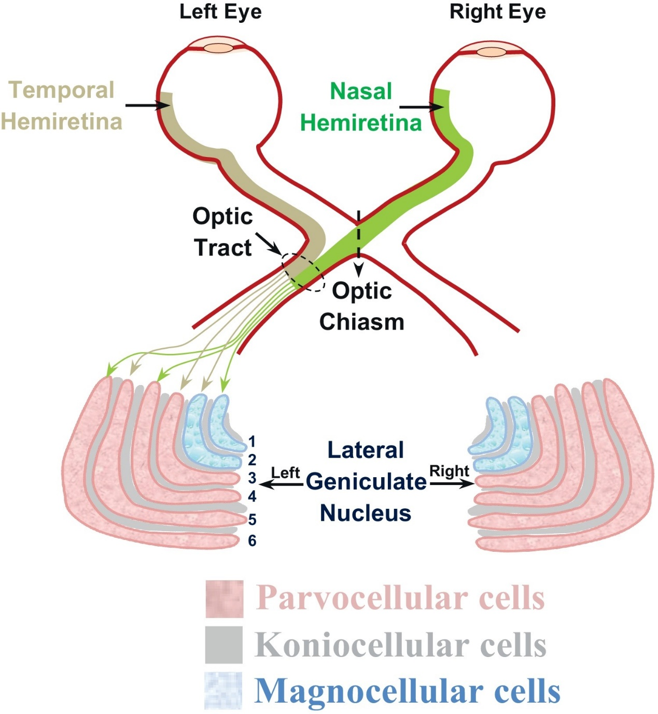
Neural mechanisms of selective visual attention
Neural correlates of top-down attention
Increased firing rates of neurons encoding the attending stimulus (modulation)
Reduced variability of responses to repeated stimuli -> less noise in the signal
Reduced covariability of neuronal responses to repeated stimuli in simultaneously recorded neurons -> reduced redundancy in the signal
In other words: if I focus more on what I see I perceive it better
E.g. Binocular, scanning behaviour

Slide 17
Neural mechanisms of selective visual attention
Neural correlates of bottom-up attention
Pop-out stimuli draw attention automatically
Increased firing rates of neurons generating attentional salience to unattended stimulus
In other words: if something is very stimulating my attention is drawn to it
E.g. Light, fast moving object, reproductive organs

Slide 18
Visual Attention
Sampling & Prioritizing what we perceive
Cannot take in all visual information at once.
Therefore, shift attention around environment to focus on important sources of information.
‘Spotlight’ metaphor
Attention is like a spotlight which moves about and allows us to selectively attend to parts of the visual world.
Michael Posner (1980) suggested that enhanced processing/detection occurs within this ‘spotlight’.
So attention is directed towards ‘space’ according to the spotlight model. It is a space-based model of attention.
How do computers differ?
How do we decide what are appropriate perceptual features for object detection?

Slide 19
Break
Take a walk of 5 minutes and meet me at the Innovation Square!
Be back in 20 minutes for the tutorial!

